Slide 1
Transaction Management (JDBC)
By,
Nirali Varnagar

Slide 2
Transaction management
The ACID properties describes the transaction management well. ACID stands for Atomicity, Consistency, isolation and durability.
Atomicity means either all successful or none.
Consistency ensures bringing the database from one consistent state to another consistent state.
Isolation ensures that transaction is isolated from other transaction.
Durability means once a transaction has been committed, it will remain so, even in the event of errors, power loss etc.

Slide 3
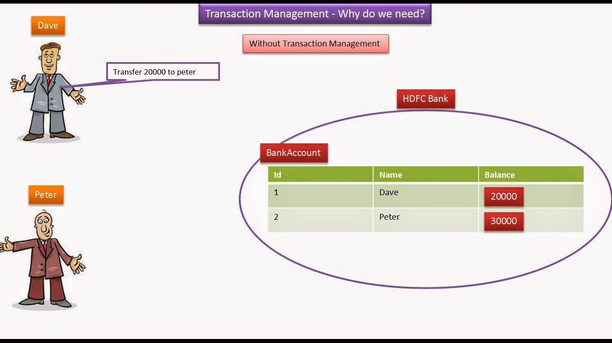

Slide 4
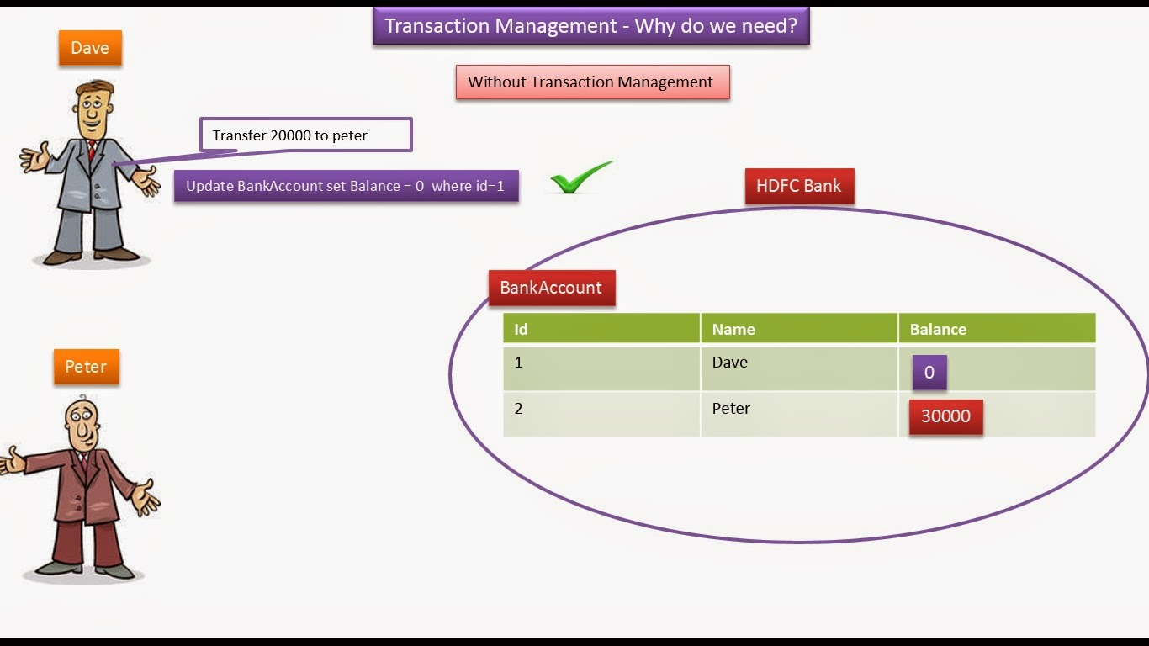

Slide 5
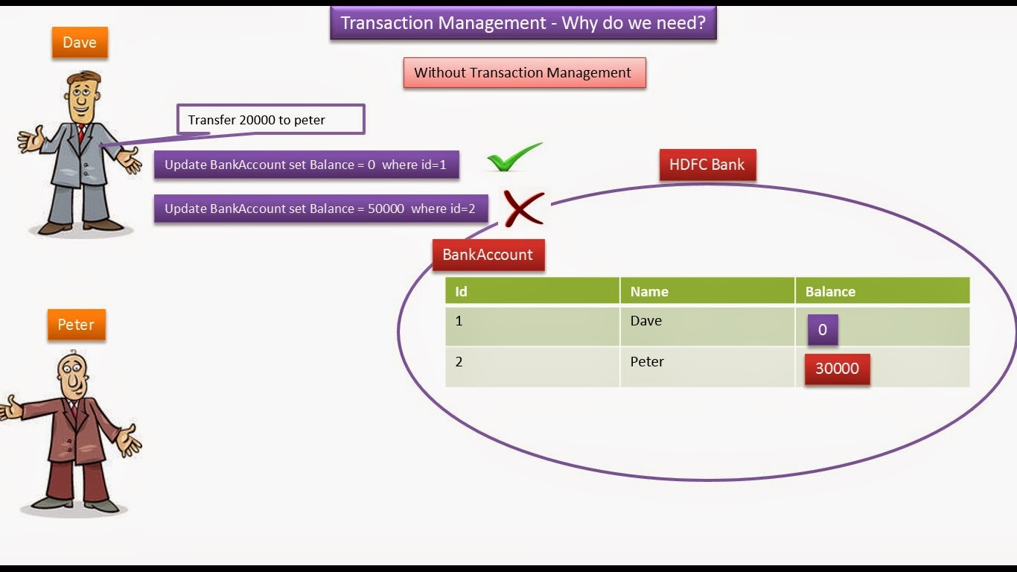

Slide 6
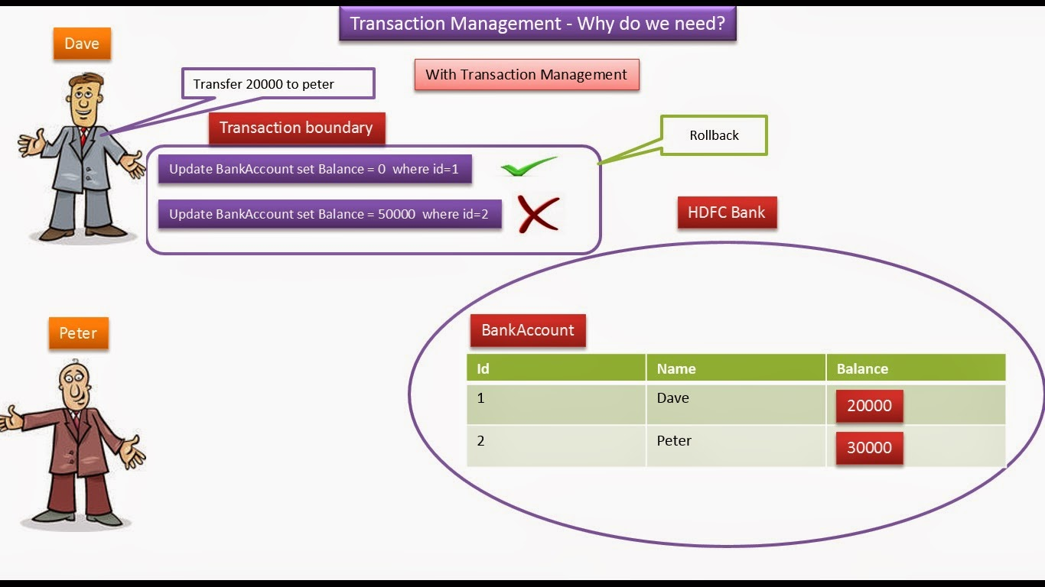

Slide 7
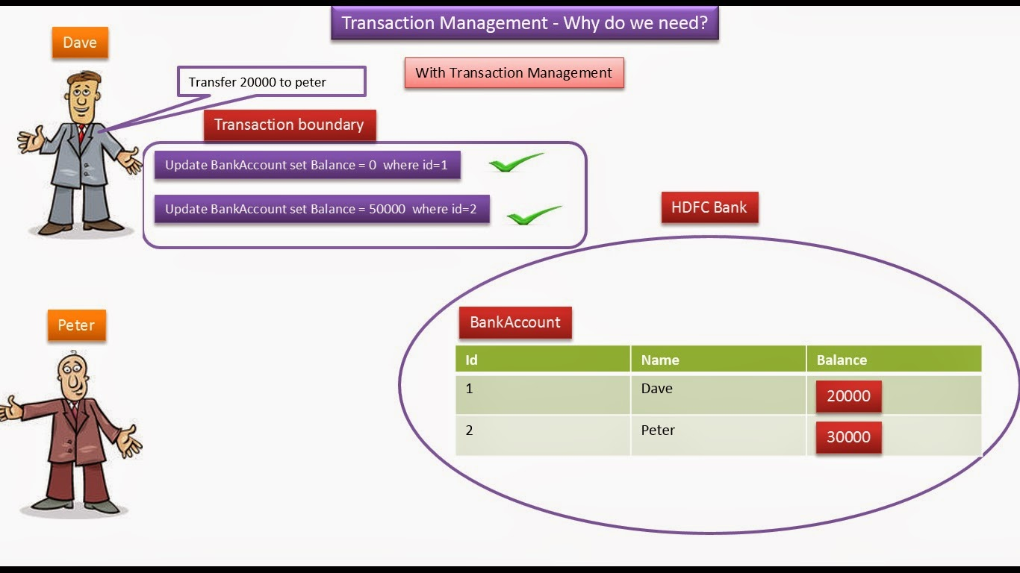

Slide 8
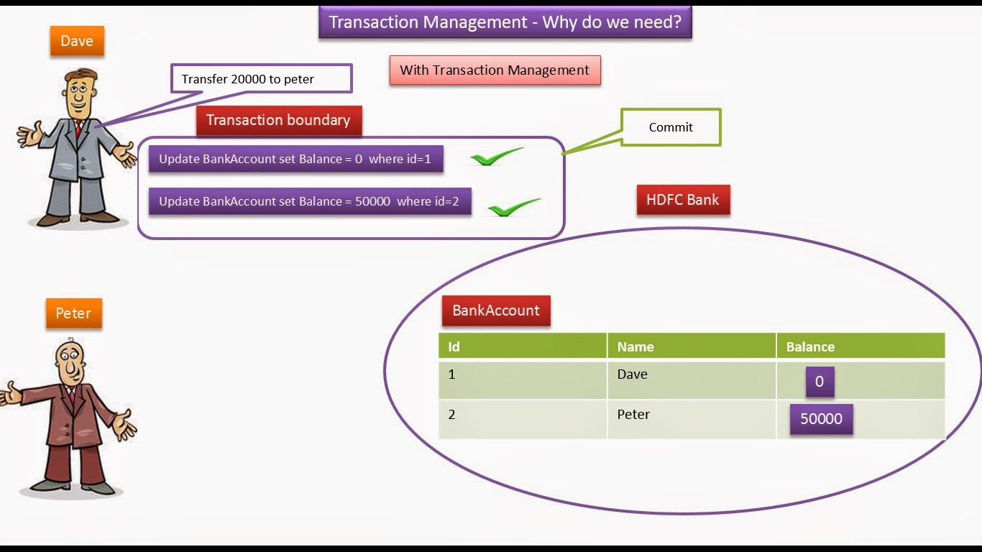

Slide 9
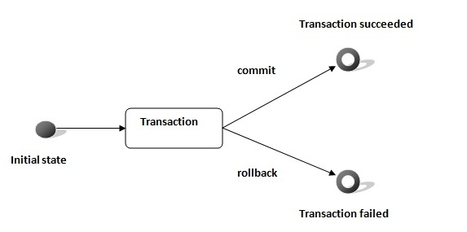

Slide 10
In JDBC, Connection interface provides methods to manage transaction.
Method | Description
void setAutoCommit(boolean status) | It is true bydefault means each transaction is committed bydefault.
void commit() | commits the transaction.
void rollback() | cancels the transaction.

Slide 11
Ex:Write a program for Transaction management of the student table , perform insertion using PreparedStatement ,enter the data using keyboard. If user entered commit then after commit the transaction, if user entered “n” then break it.

Slide 12
Using Savepoints
The new JDBC 3.0 Savepoint interface gives you the additional transactional control. Most modern DBMS, support savepoints within their environments such as Oracle's PL/SQL.
When you set a savepoint you define a logical rollback point within a transaction. If an error occurs past a savepoint, you can use the rollback method to undo either all the changes or only the changes made after the savepoint.

Slide 13
The Connection object has two new methods that help you manage savepoints −
setSavepoint(String savepointName): Defines a new savepoint. It also returns a Savepoint object.
releaseSavepoint(Savepoint savepointName) : Deletes a savepoint. Notice that it requires a Savepoint object as a parameter. This object is usually a savepoint generated by the setSavepoint() method.
There is one:
rollback (String savepointName) method, which rolls back work to the specified savepoint.

Slide 14
JDBC - Batch Processing
Batch Processing allows you to group related SQL statements into a batch and submit them with one call to the database.
When you send several SQL statements to the database at once, you reduce the amount of communication overhead, thereby improving performance.

Slide 15
The addBatch() method of Statement, PreparedStatement, andCallableStatement is used to add individual statements to the batch. The executeBatch() is used to start the execution of all the statements grouped together.
The executeBatch() returns an array of integers, and each element of the array represents the update count for the respective update statement.
Just as you can add statements to a batch for processing, you can remove them with the clearBatch() method. This method removes all the statements you added with the addBatch() method. However, you cannot selectively choose which statement to remove.

Slide 16
Batching with Statement Object
Here is a typical sequence of steps to use Batch Processing with Statement Object −
Create a Statement object using either createStatement() methods.
Set auto-commit to false using setAutoCommit().
Add as many as SQL statements you like into batch using addBatch()method on created statement object.
Execute all the SQL statements using executeBatch() method on created statement object.
Finally, commit all the changes using commit() method.

Slide 17
There are Three types of Transaction:
Local Transaction
Distributed Transaction
Nested Transaction

Slide 18
How to set isolation level
Con.setTransactionIsolation (level)
DBC Defined Constant | Description
TRANSACTION_READ_UNCOMMITTED | Allows dirty reads, non-repeatable reads, and phantom reads to occur.
TRANSACTION_READ_COMMITTED | Ensures only committed data can be read.
TRANSACTION_REPEATABLE_READ | Is close to being "serializable," however, "phantom" reads are possible.
TRANSACTION_SERIALIZABLE | Dirty reads, non-repeatable reads, and phantom reads are prevented. Serializable.

Slide 19
JDBC - Exceptions Handling
Package: java.sql.SQLException
An SQLException can occur both in the driver and the database. When such an exception occurs, an object of type SQLException will be passed to the catch clause.

Slide 20
The passed SQLException object has the following methods
Method | Description
getErrorCode( ) | Gets the error number associated with the exception.
getMessage( ) | Gets the JDBC driver's error message for an error, handled by the driver or gets the Oracle error number and message for a database error.
getSQLState( ) | Gets the XOPEN SQLstate string. For a JDBC driver error, no useful information is returned from this method. For a database error, the five-digit XOPEN SQLstate code is returned. This method can return null.
getNextException( ) | Gets the next Exception object in the exception chain.
printStackTrace( ) | Prints the current exception, or throwable, and it's backtrace to a standard error stream.
printStackTrace(PrintStream s) | Prints this throwable and its backtrace to the print stream you specify.
printStackTrace(PrintWriter w) | Prints this throwable and it's backtrace to the print writer you specify.

Slide 21
SQLWarning:
➔public SQLWarning(java.lang.String reason)
Constructs an SQLWarning object with the given value for a reason;
SQLstate defaults to null, and vendorCode defaults to 0.
Parameters:
reason - a description of the warning
Method Detail
SQLWarning
public SQLWarning()
Constructs a default SQLWarning object. The reason defaults to null, SQLState defaults to null, and vendorCode defaults to 0.
getNextWarning:
public SQLWarning getNextWarning()
Retrieves the warning chained to this SQLWarning object.

